Slide 1

NHS Wales GP Experience
Patient Survey Results 2024/25

Slide 2
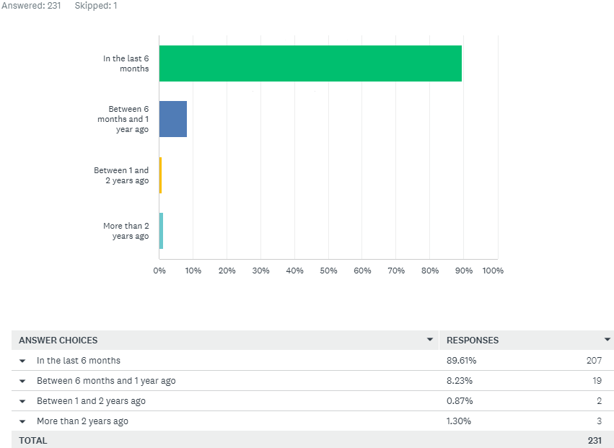
Q1: How recent was the experience you are thinking of?

Slide 3
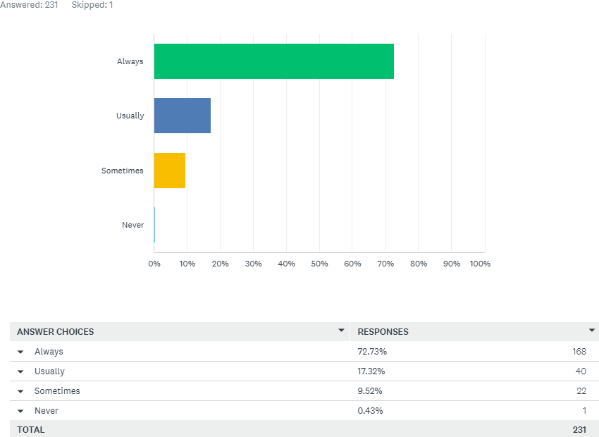
Q2: Thinking about your overall first impressions of the care you received: Did you feel that you were listened to?

Slide 4
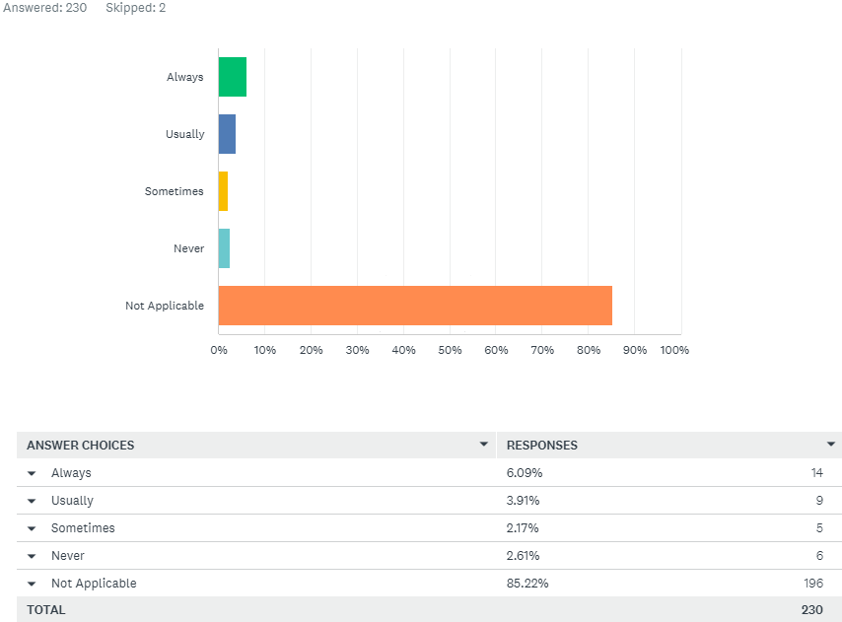
Q3: Were you able to speak in Welsh to staff if you needed to?

Slide 5
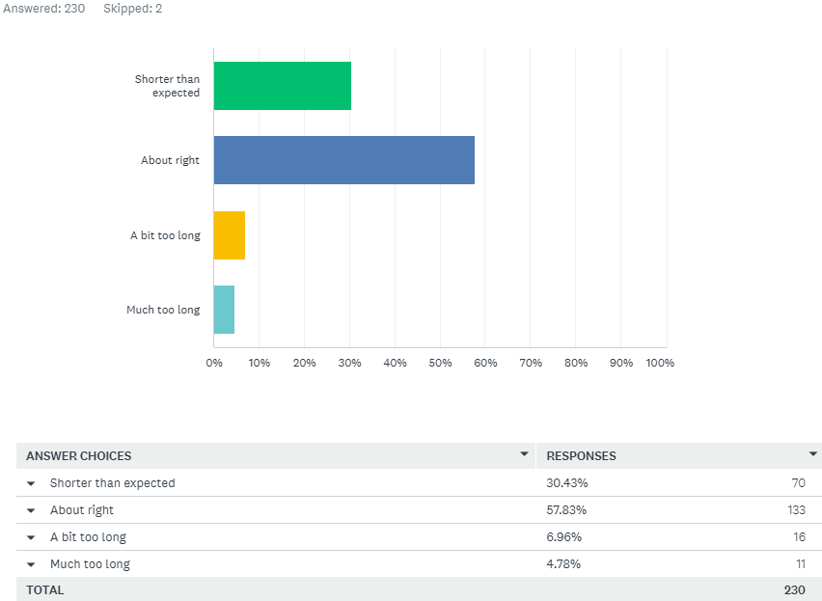
Q4: From the time you realised you needed to use this service, was the time you waited:

Slide 6
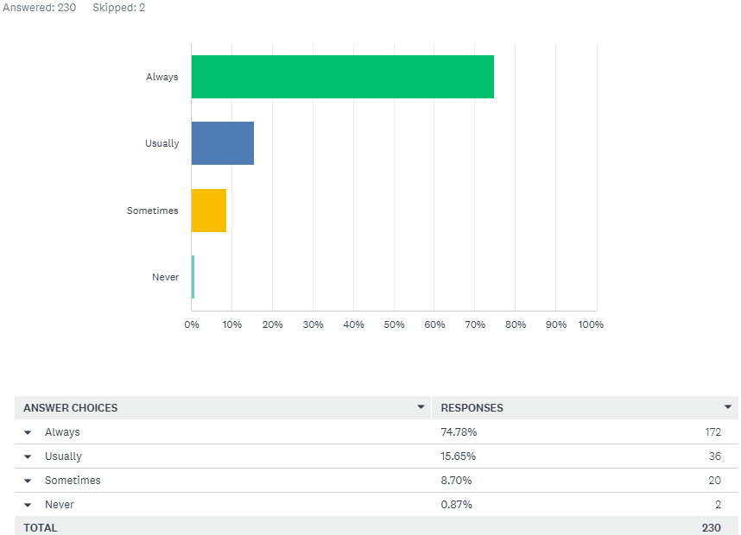
Q5: Thinking about the place where you received your care: Did you feel well cared for?

Slide 7
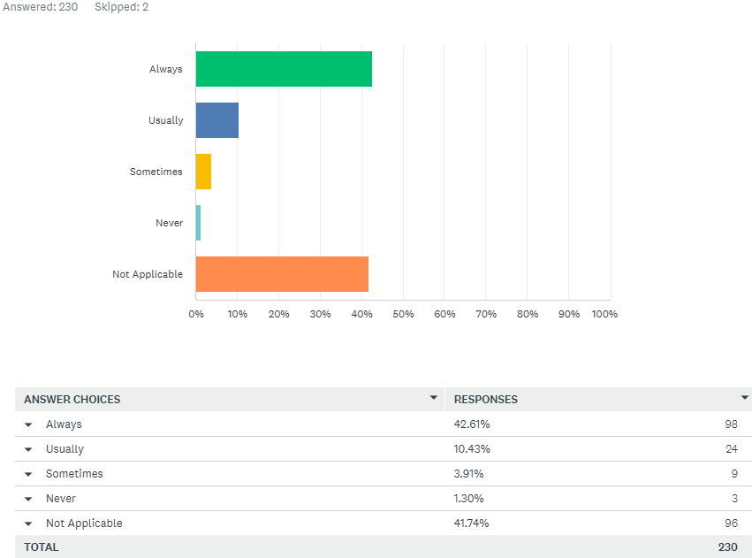
Q6: If you asked for assistance, did you get it when you needed it?

Slide 8

Q7: Thinking about your understanding and involvement in care: Did you feel you understood what was happening in your care?

Slide 9
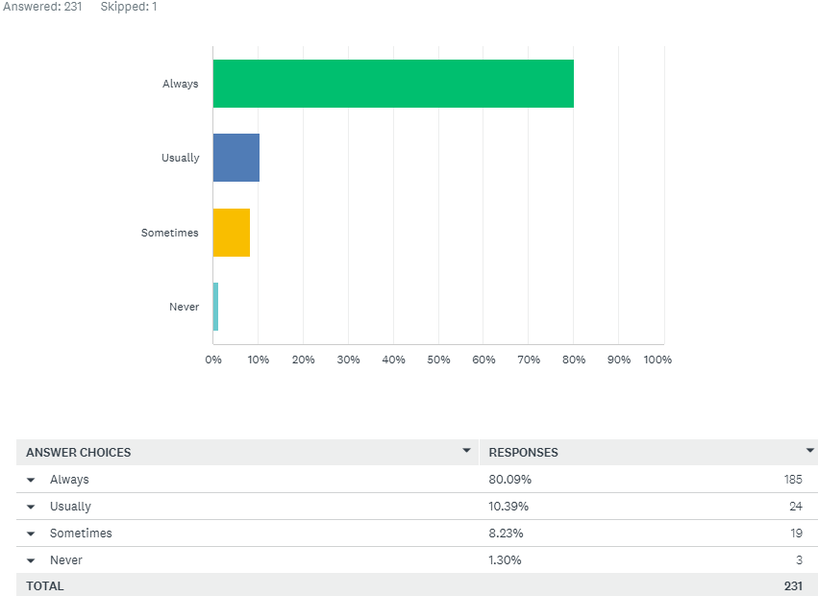
Q8: Were things explained to you in a way that you could understand?

Slide 10
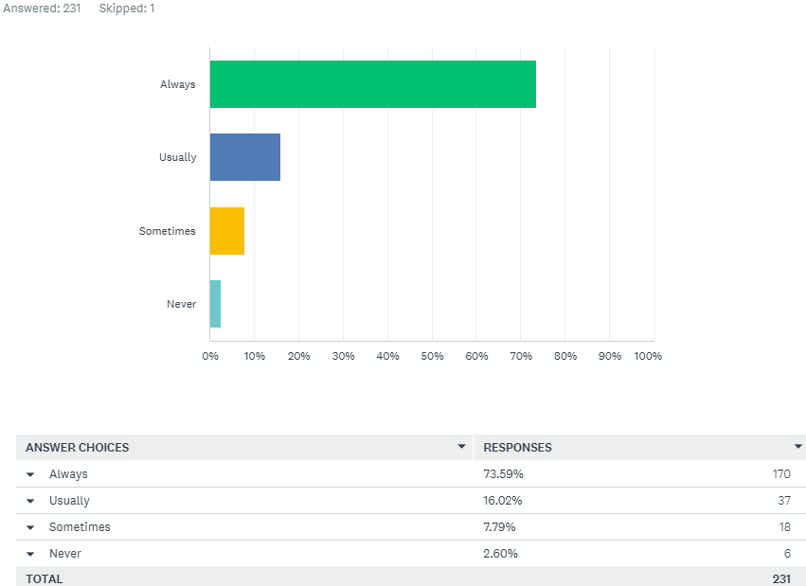
Q9: Were you involved as much as you wanted to be in decisions about your care?

Slide 11
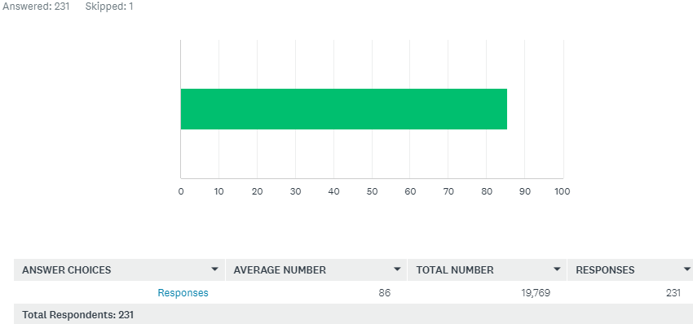
Q10: Using a scale of 0 – 10 where 0 is very bad and 10 is excellent, how would you rate your overall experience?

Slide 12
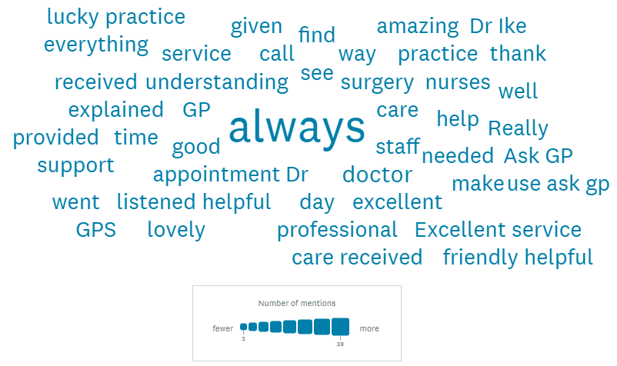
Q11: Thinking of your responses:
Was there anything particularly good about your experience that you would like to tell us about?

Slide 13
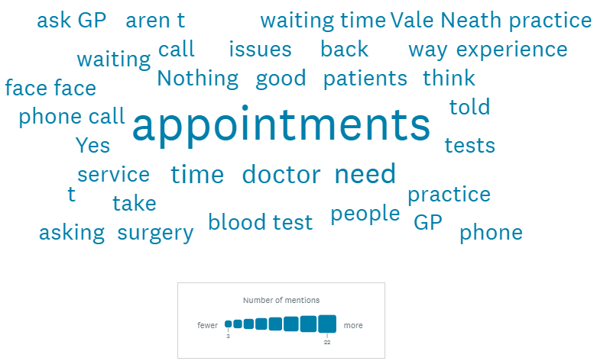
Q12: Was there anything that we could change to improve your experience?

Slide 14
Q13: Equality Monitoring
We are committed to ensuring that everyone receives fair and equal respect. Whatever your age, disability, ethnicity, faith, gender reassignment or sexual identity, you can expect to be treated with dignity. We can only achieve this with your help by providing the information below. Data will be used for monitoring purposes only and held in strictest confidence. Your identity will not be disclosed to anyone.

Slide 15
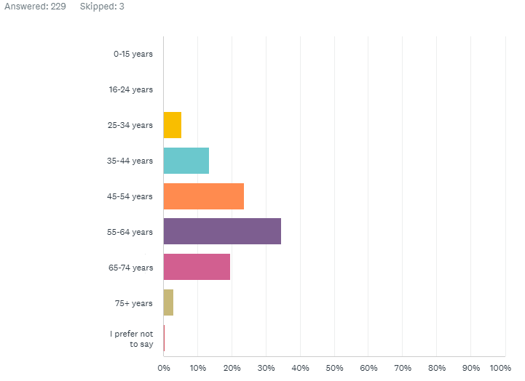
Q14: What is your age?

Slide 16
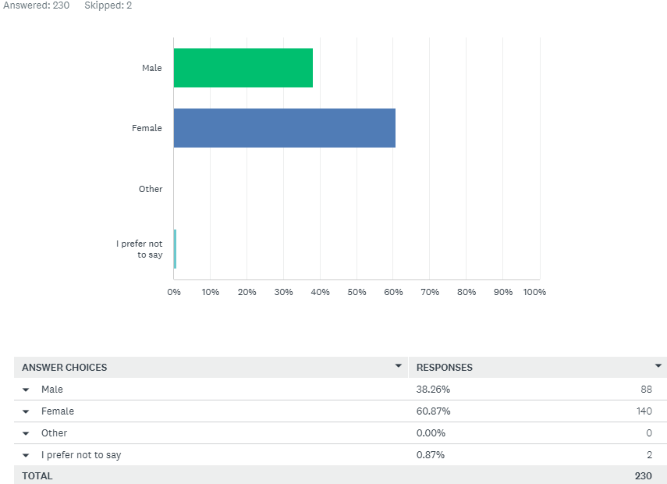
Q15: What is your gender?

Slide 17
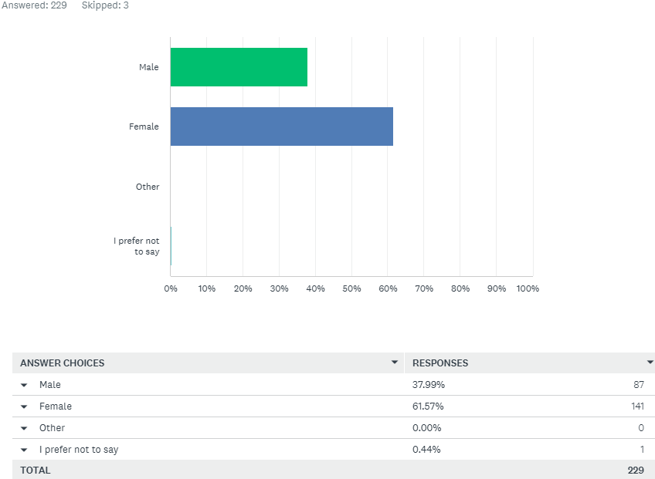
Q16: At birth, were you described as:

Slide 18
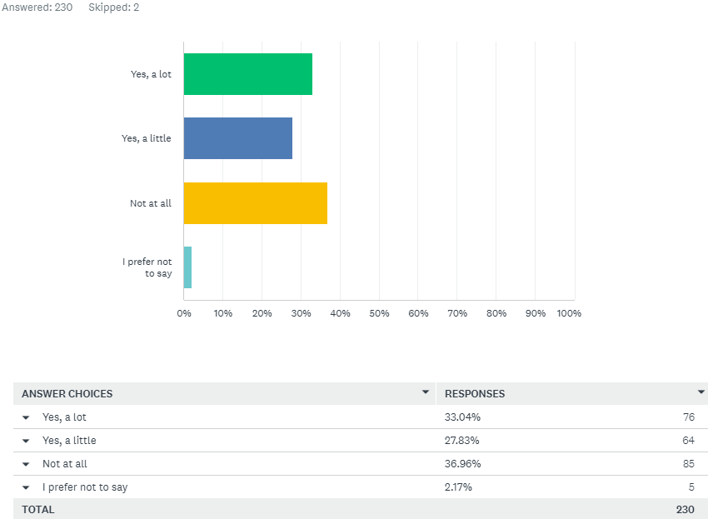
Q17: Are your day-to-day activities limited because of a health problem or disability which has lasted, or is expected to last, at least 12 months?

Slide 19
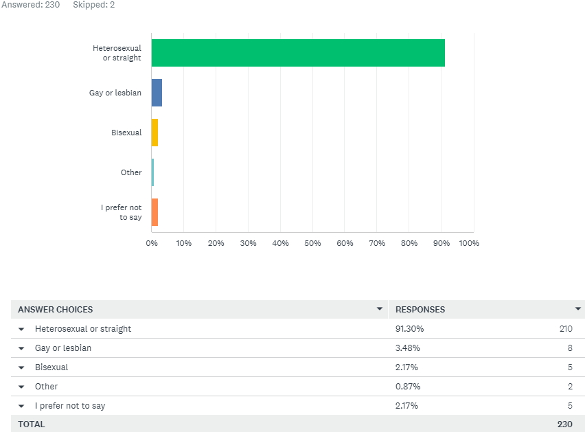
Q18: Which of the following options best describes how you think of yourself?

Slide 20
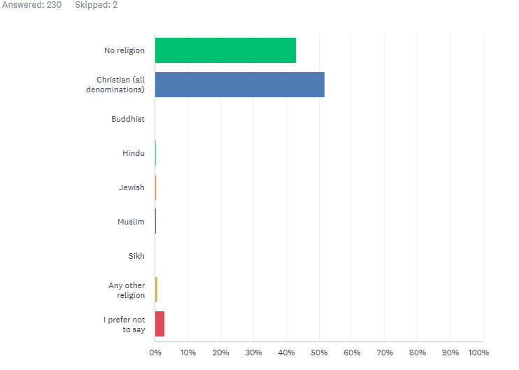
Q19: What is your religion? (Please choose one option that best describes your religion)

Slide 21
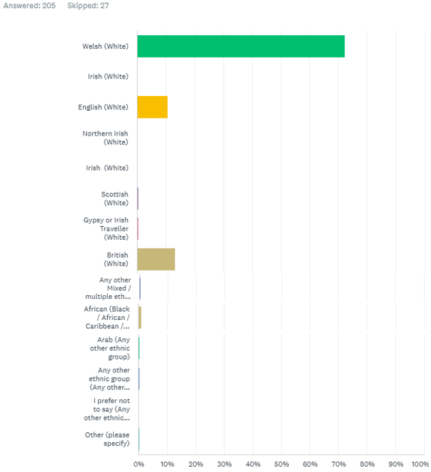
Q20: What is your ethnic group? (Please choose one option that best describes your ethnic group or background)

